Slide 1
Interface Segregation Principle
based on an article of that name by Robert Martin

Slide 2
Interface Segregation Principle
“The dependency of one class on another should depend on the smallest possible interface.”
Or, In simple words…
“Many client specific interfaces are better than one general purpose interface.”
C1
C2
C3
C1
C2
C3

Slide 3
ISP: Background
Rather than implementing new interfaces:
  A programmer often changes an interface of a class to extend its capability.
  Objects progressively sport fat interfaces…
  However, clients use just those methods that they require…

Slide 4
ISP Overview ...
General purpose servers:
  Methods fall into different groups
  Not all clients use all methods
Can lead to unwanted dependencies
  Clients using one aspect of a class also depend indirectly on the dependencies of the other aspects
ISP helps to solve the problem:
  Use several client-specific interfaces!
C1
C2
C3
C1
C2
C3

Slide 5
Case for ISP
It is much better to have separate interfaces for multiple components:
  One appropriate for each client.
  Otherwise, when we change an interface we affect even those clients that do not use the features we change.
C1
C2
C3
C1
C2
C3

Slide 6
Intent of ISP
We should try to have interfaces immutable as far as possible.
However, when interfaces change:
  It is important to keep the impact of changing an interface localized…
C1
C1
C2
C2
C3
C3

Slide 7
ISP: Statement of Principle
Clients should not be forced to use parts of interfaces they do not use.
Create interfaces to satisfy the exact needs of clients.
  A common pitfall of programmers’ is that when a component has several different clients --- they are tempted to provide a large interface that satisfies the needs of all clients.

Slide 8
Fat Interface
Is it violating any other principle that we have already discussed?
Client A
Service
✗
<<Client A Methods>>
+…
<<Client B Methods>>
+…
<<Client C Methods>>
+…
Client B
Client C
One should not certainly use this design…

Slide 9
OCP Compliant, but not exactly a good design…
Client A
Service
✗
<<Client A Methods>>
+…
<<Client B Methods>>
+…
<<Client C Methods>>
+…
Client B
Service interface
Client C

Slide 10
Segregated Interfaces
<<interface>>
Service A
✓
Client A
<<Client A Methods>>
+…
Service
<<Client A Methods>>
+…
<<Client B Methods>>
+…
<<Client C Methods>>
+…
<<interface>>
Service B
Client B
<<Client B Methods>>
+…
<<interface>>
Service C
Client C
<<Client C Methods>>
+…

Slide 11
Summary
When a class (Server) needs to serve various types of clients
  Leads to a fat interface unless care is taken…
The Interface Segregation Principle states that:
  Fat interfaces lead to inadvertent couplings between clients that ought to be isolated.
Fat interfaces can be segregated:
  One way: Server should implement multiple interfaces to break unwanted coupling between components.
  Clients can use the appropriate interfaces.

Slide 12
Design Patterns

Slide 13
Design Patterns
Patterns are extensively being used as “building blocks” in software design.
  Help designers to make important design decisions correctly.
If you can master a few important patterns:
  You can easily spot them in your next application design problem and use pattern solutions.

Slide 14
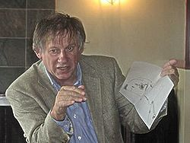




Origin of Patterns
Roots in the architecture field:
  Made prominent by Christopher Alexander (1977)

Slide 15

Christopher Alexander, A Pattern Language, 1977
Each pattern:
  Describes an architectural design problem which occurs over and over again…
  Describes the core of the solution to that problem, in such a way that you can use this pattern solution solution a million times over, without ever doing it in the same way twice.

Slide 16



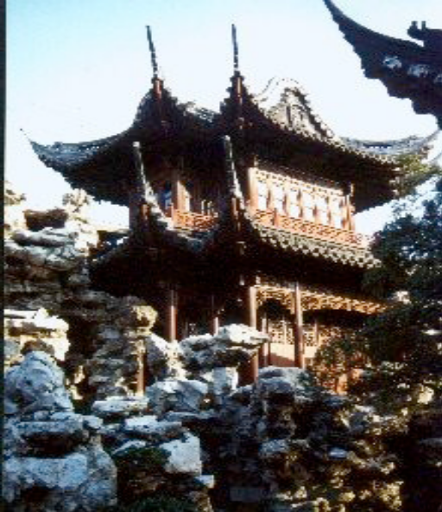
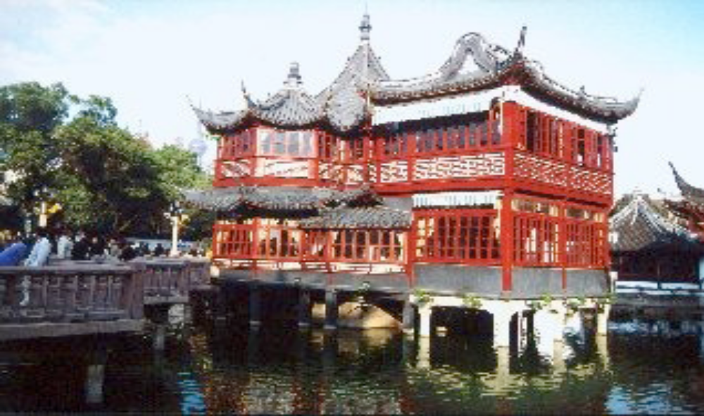
… use this solution a million times over, without ever doing it the same way twice... Christopher Alexander

Slide 17
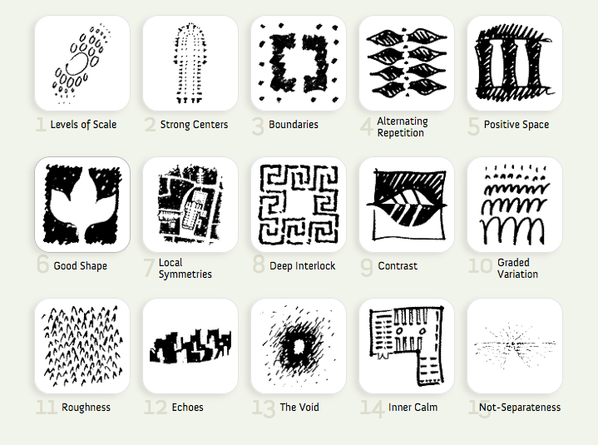
Christopher Alexander, A Pattern Language, 1977
253 patterns formed the vocabulary of the language.
Each pattern describes a problem:
  and then offers a solution.
They give ordinary people as well as professionals:
  A way to design a house, improve a town or neighborhood, etc…

Slide 18
Patterns in Engineering
How do designers in other engineering fields find and use patterns?
  Mature engineering disciplines have handbooks
  describing successful solutions to known problems
  Automobile designers don't design cars from scratch.
  Instead, they reuse standard designs with successful track records.
Should software engineers make use of patterns?
  Developing software from scratch is expensive
  Patterns support reuse of past knowledge mainly in the form of software architecture and design.

Slide 19
Patterns in Software Design
Architectural Patterns: MVC, Layers etc.
GoF Design Patterns: Singleton, Observer etc
GUI Design Patterns: Window per task, Disabled irrelevant things, Explorable interface etc
Database Patterns: decoupling patterns, resource patterns, cache patterns etc.
Concurrency Patterns: Double buffering, Lock object, Producer-consumer,Asynchronous processing etc.
Enterprise (J2EE) Patterns: Data Access Object, Transfer Objects etc.
GRASP (General Responsibility Assignment Patterns): Low coupling/high cohesion, Controller, Law of Demeter (don’t talk to strangers), Expert, Creator etc.
Anti-patterns (Bad solutions deceptively appear good): God class,Singletonitis, Basebean, Golden hammer, etc.

Slide 20




History of Design Patterns
The concept of a "pattern“:
  First expressed in Christopher Alexander's work A Pattern Language in 1977
  A solution to a common design problem in a certain context.
In 1990:
  Gang of Four or "GoF" (Gamma, Helm, Johnson, Vlissides) compiled a catalog of design patterns
Now assimilated into programming languages:
  Example: Decorator, Composite, Iterator pattern:
  Defines an interface that declares methods for sequentially accessing the objects in a collection.

Slide 21
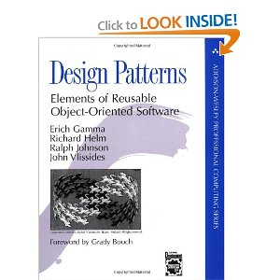
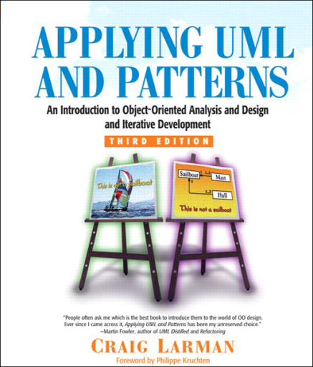
“Gang of four” (GoF) and GRASP Patterns
Erich Gamma, Richard Helm, Ralph Johnson & John Vlissides : (Addison-Wesley, 1995)
  Design Patterns book catalogs 23 different patterns
Larman:
  GRASP (General Responsibility Assignment Software Patterns) pattern
Several other types of patterns are also popular.

Slide 22
Elements of Design Patterns
Design patterns have 4 essential elements:
  Pattern name: Forms designers’ vocabulary
  Problem: intent, context, when to apply
  Solution: UML model, skeletal code
  Consequences: results and tradeoffs

Slide 23
Goals of Design Patterns
Codify good design
      Distill & generalize experience
      Aid to novices & experts alike
Give design structures explicit names
      Common vocabulary
Save design iterations
      Improve documentation
      Improve understandability
      Facilitate restructuring/refactoring

Slide 24
Types of Patterns
Architectural patterns
Design patterns
Code patterns (Idioms)‏

Slide 25
Architectural Patterns
Architectural designs concern the overall structure of software systems.
  Architectural designs cannot directly be programmed.
  Form a basis for more detailed design.
Architectural patterns:
  Provide solutions to issues relevant to architectural design of large problems.

Slide 26
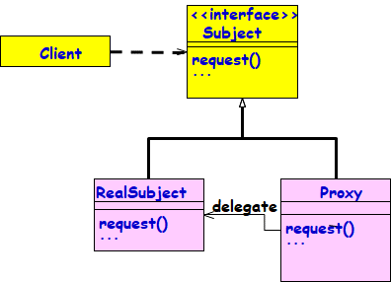
Design Patterns
A design pattern:
  Suggests a scheme for structuring the classes in a design solution.
  Also, defines the interactions required among those classes.
Design pattern solutions are described in terms of:
  Classes, their instances, their roles and collaborations.

Slide 27
Idioms
Idioms are low-level patterns:
  Programming language-specific.
  Describe how to implement a solution to a particular problem in a given programming language.

Slide 28
Idioms
Idioms in English language:
  A group of words that has meaning different from a simple juxtaposition of the meanings of the individual words.
  Example: “Raining cats and dogs”
A C idiom:
  for(i=0;i<1000;i++){
  }

Slide 29
Patterns versus Idioms
A pattern:
  Describes a recurring problem
  Describes a core solution
  Can be used to come up with many distinct designs
An Idiom though describes solution to a recurring problem, is rather restricted:
  Provides only a specific solution, with fewer variations.
  Applies only to a narrow context
    e.g., C++ or Java language

Slide 30
Antipatterns
If a pattern represents a best practice:
  An antipattern represents lessons learned from a bad design.
Antipatterns help to recognise deceptive solutions:
  They appear attractive at first, but turn out to be a liability later…
Not enough to use patterns in a solution --–must consciously avoid antipatterns.

Slide 31
Patterns versus Algorithms
Are patterns and algorithms identical concepts?
  After all, both target to provide reusable solutions to problems!
Algorithms primarily focus on solving problems with reduced space and/or time requirements:
  Patterns focus on understandability and maintainability of design and easier development.

Slide 32
Pros of Design Patterns
Help capture and disseminate expert knowledge.
  Promotes reuse and helps avoid mistakes.
Provide a common vocabulary:
  Help improve communication among the developers.
  “The hardest part of programming is coming up with good variable and function names.”
Reduces the number of design iterations:
  Helps improve the design quality and designer productivity.

Slide 33
Cons of Design Patterns
Design patterns do not directly lead to code reuse.
How to select the right design pattern at the right point during a design exercise?
  At present no systematic methodology exists.

Slide 34
Patterns put you on the shoulders of Giants
Isaac Newton famously remarked in a letter to Robert Hooke, in 1676:
  "If I have seen a little further, it is by standing on the shoulders of Giants.”
When Hamming received the Turing award in 1968. He remarked:
  “While Newton may have stood on the shoulders of Giants; in software development, sadly we stand on each other’s feet.”

Slide 35
Themes Central To Design Patterns
Patterns exempify solutions to software problems making use of:
  Abstraction,
  Encapsulation
  SRP, OCP, LSP, ISP, DIP
  Separation of concerns
  Coupling and cohesion
  Divide and conquer

Slide 36
Why Learn Design Patterns?
Your own designs will improve:
  Learn to borrow from well-tested ideas
  Learn from pattern descriptions that usually contain some analysis of tradeoffs
You will be able to describe complex design ideas to others:
  Assuming that they also know the same patterns
You can use patterns to “refactor” existing code:
  Improve the structure of existing code without adding new functionality
You can understand why some aspects of Java language are that way.
BufferedReader bufferedreader = new BufferedReader(new InputStreamReader(System.in))

Slide 37
Thought for the day…
Why are there no design patterns for procedural designs? ….

Slide 38
Why No Patterns for Procedural Development?
For patterns to be defined, procedural languages need to support:
  Inheritance
  Abstract classes and Interfaces
  Polymorphism
  Encapsulation

Slide 39
Design Patterns
These are standard solutions to commonly recurring problems.
  Provide good solutions based on common sense
Pattern has four important parts:
  The problem
  The context
  The solution
  The context in which it works or does not work

Slide 40
Pattern: Problem Statement
Problem statement describes when to apply the pattern.
  It explains the problem and its context.
  It might describe situations where it works and does not work.
  It can include a list of conditions that must be met before it makes sense to apply the pattern.

Slide 41
Pattern Solution
Abstract description of the design solution:
  Overall idea behind how the pattern solves it
Design solution is given in terms of:
  Classes,
  Class relationships,
  Class responsibilities and
  Class collaborations
Only skeletal implementation may be provided.

Slide 42
Design Patterns are NOT…
Designs that can be plugged in and reused as it is:
  Unlike code for linked lists, hash tables, etc…
Complex domain-specific designs:
  For an entire application or subsystem.
Patterns are actually:
  “Descriptions of communicating objects and classes that are to be customized to solve a general design problem in a particular context.”

Slide 43
GRASP Patterns

Slide 44
GRASP Patterns
GRASP: Generalized Responsibility Assignment Software Patterns:
  Larman, “Applying UML and Patterns”
GRASP patterns can more accurately be described as best practices:
  If used judiciously, will lead to maintainable, reusable, understandable, and easy to develop software

Slide 45
GRASP Patterns
GRASP patterns essentially describe how to assign responsibilities to classes:
  Warning: Some Grasps tend to be vague and need to be seen as guidelines rather than solutions.
What is a responsibility?
  A contract or obligation of a class
  Responsibilities can include behaviour, data storage, object creation, etc.
  Usually fall into two categories:
    Doing
    Knowing

Slide 46
Responsibility-Driven Design (RDD)
Advocates carrying out OOD by assigning:
    Responsibilities
    Roles
    Collaborations
Common responsibility categories:
  Doing:
    Creating an object or doing a calculation
    Initiating action in other objects
  Knowing:
    Knowing about private data
    Knowing about related objects
    Knowing about things it can derive or calculate

Slide 47
Responsibilities
Responsibilities are implemented by methods:
  Some methods act alone and do a job
  Some collaborate with other objects
  Example: SaleTransaction class has total()
  total() collaborates with subtotal() method of SaleLineItem object
1:total
:SaleTransaction
2: subTotal
:SaleLineItem
3: price
:ItemSpecification

Slide 48
9 GRASP Patterns
Creator
  Who creates an object?
Information Expert
  Which class should be responsible?
Low Coupling
  Support low dependency and increase reuse
Controller
  Who handles a system event?
High Cohesion
  How to keep complexity manageable?
Polymorphism
  How to handle behavior that varies by type?
Pure Fabrication
  How to handle a situation, when you do not want to violate High Cohesion and Low Coupling?
Indirection
  How to avoid direct coupling?
Law of Demeter (Don’t talk to strangers)
  How to avoid knowing about unassociated objects?

Slide 49
Grasp Patterns

Slide 50
Expert Pattern
Problem: Which class should be responsible for doing a certain thing?
Solution:
  Assign responsibility to the expert (class that has all/most information necessary to fulfil the required responsibility).

Slide 51
Which class is information expert for computing total price of a sales transaction?
SaleTrans
date
SalesLineItem
Product Specification
quantity
description
price
Warranty

Slide 52
Example 1: Expert
Cont…
SaleTransaction
1
*
SaleLineItem
1
1
ItemSpecification
Class Diagram
1:total
2: subTotal
3: price
:SaleTransaction
:SaleLineItem
:ItemSpecification
Collaboration Diagram

Slide 53
Sale
date
getTotal
SalesLineItem
Product
quantity
description
price
itemID
getSubTotal
getPrice

Slide 54
Example 2:Tic-Tac Toe
Board
Initial domain model
PlayMoveBoundary
PlayMoveController
Board
Refined domain model
Which class should check game result after a move?
Which class should play the computer’s move?

Slide 55
Example 2: Sequence Diagram
:playMove
Boundary
:playMove
Controller
:board
acceptMove
checkMoveValidity
move
[invalidMove]
[invalidMove]
announceInvalidMove
announceInvalidMove
checkWinner
[game over]
[game over]
announceResult
announceResult
playMove
checkWinner
[game over]
[game over]
announceResult
announceResult
displayBoardPositions
getBoardPositions
[game not over]
promptNextMove
Sequence Diagram for the play move use case

Slide 56
Expert Pattern: An Analysis
Expert improves cohesion.
  Cohesion: the degree to which the information and responsibilities of a class are related to each other
How cohesion is improved?
  The information needed for a responsibility is in the same class as the responsibility itself.

Slide 57
Creator Pattern: Background
Every object must be created somewhere.
Consider making a class responsible for creating an object if:
  It is an inventory of objects of that type.
  It has the information needed to initialize the object.
  It will be the primary client of the object.
In a Library software, who creates a Member?

Slide 58
Creator Pattern
Problem: Which class should be responsible for creating a new instance of some class?
Solution: Assign a class C1 the responsibility to create class C2 if
  C1 is an aggregates objects of type C2
  C1 contains object of type C2
  C1 closely uses C2
  C1 has the initializing data for C2

Slide 59
Example 2: Use Case Model
Supermarket
Prize scheme
register
customer
Customer
Clerk
register
sales
Sales Clerk
select
winners
Manager

Slide 60
Example 2: Initial Domain Model
SalesHistory
CustomerRegister
1
1
*
*
SalesRecords
CustomerRecord
Initial domain model

Slide 61
Example 2: Refined Domain Model
SalesHistory
CustomerRegister
1
1
*
*
SalesRecords
CustomerRecord
RegisterCustomerBoundary
RegisterCustomerController
RegisterSalesBoundary
RegisterSalesController
SelectWinnersBoundary
SelectWinnersControllers
Refined Domain Model

Slide 62
Example 2: Sequence Diagram for the Register Customer Use Case
:RegisterCustomer
Boundary
:RegisterCustomer
Controller
:Customer
Register
:Customer
Record
register
register
checkDuplicate
*match
[duplicate]
showError
generateCIN
create
:Customer
Record
register
displayCIN
Sequence Diagram for the register customer use case

Slide 63
Example 2: Sequence Diagram for the Register Sales Use Case
:Register
Sales
Boundary
:Register
Sales
Controller
:Sales
History
RegisterSales
registerSales
registerSales
:Sales
Record
create
confirm
confirm
Sequence Diagram for the register sales use case

